Slide 1
SARANYA V .
821721104053
BE COMPUTER SCIENCE AND ENGINEERING
SIR ISSAC NEWTON COLLEGE OF ENGINEERING
AND TECHNOLOGY

Slide 2
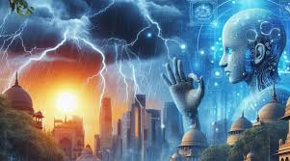
WEATHER PREDICTION (RNN)

Slide 3


AGENDA
Weather prediction, also known as weather forecasting, is the science of predicting the state of the atmosphere at a specific location and time in the future. It plays a crucial role in various sectors such as agriculture, transportation, energy, and disaster management, as it helps individuals and organizations make informed decisions based on expected weather conditions.
Data Collection : Gathrering data from various sources.
Data Analysis : Processing and Analyzing.
Model Initialization : Using mathematical model.
Model Simulation : Running numerical weather prediction.
Post-Processing : Refining model output.
Verification : Evaluating the accuracy of the forecast.
Communication : Presenting the forecast information.
3/21/2024 Annual Review

Slide 4

PROBLEM STATEMENT
The problem statement of weather prediction using Recurrent Neural Networks (RNNs) involves utilizing historical weather data to forecast future weather conditions. This typically entails inputting past weather patterns such as temperature, humidity, wind speed, and precipitation into an RNN model, which then learns the temporal dependencies within the data to make predictions about future weather conditions, such as temperature, rainfall, etc.
The problem statement of weather prediction using Recurrent Neural Networks (RNNs) typically involves training a model to forecast future weather conditions based on historical weather data

Slide 5

PROJECT OVERVIEW
Title: Weather prediction
Objective: Weather prediction using RNNs involves leveraging deep learning techniques to forecast future weather conditions based on historical data. RNNs are particularly suited for sequential data modeling, making them ideal for time series forecasting tasks like weather prediction.
Historical weather data is collected from various sources such as weather stations, satellites, or databases. The data undergoes preprocessing steps including cleaning, normalization, and feature engineering to ensure it is suitable for input into the RNN model. RNN architecture, such as LSTM (Long Short-Term Memory) or GRU (Gated Recurrent Unit), is chosen for its ability to capture temporal dependencies in the data. The architecture includes input, hidden, and output layers, with parameters tuned during training.

Slide 6
WHO ARE THE END USERS?
The end users of weather prediction include individuals and organizations across various sectors such as agriculture, transportation, energy, construction, emergency management, outdoor recreation, retail, aviation, and maritime industries. They rely on weather forecasts to make informed decisions, plan activities, optimize operations, ensure safety, and manage risks relevant to their respective fields .
These end users rely on weather predictions to make informed decisions, mitigate risks, and optimize operations in various aspects of their daily lives and professions.

Slide 7

YOUR SOLUTION AND ITS VALUE PROPOSITION
Solution: weather prediction is a complex task influenced by many factors, and the accuracy of your predictions will depend on the quality of your data, the design of your model, and other factors.
Value Proposition: The value proposition of a weather prediction system encompasses several benefits and advantages that it offers to users and stakeholders.
weather prediction system offers significant value by providing accurate forecasts, mitigating risks, optimizing operations, saving costs, improving resilience, protecting public safety and health, contributing to environmental monitoring, and generating data-driven insights for various stakeholders.

Slide 8

THE WOW IN YOUR SOLUTION
The "wow" factor in using Recurrent Neural Networks (RNNs) for weather prediction lies in their ability to analyze vast amounts of historical weather data, capture complex temporal patterns, and make accurate forecasts.
.
The solution of weather prediction using RNNs represents a groundbreaking fusion of cutting-edge technology, scientific rigor, and real-world impact, ushering in a new era of precision forecasting and resilience in the face of an ever-changing climate.
.
3/21/2024 Annual Review

Slide 9
MODELLING
The modeling of a weather prediction system involves creating a predictive model that can accurately forecast weather conditions based on historical data.
you can build and deploy a robust weather prediction system capable of providing accurate forecasts to support various applications and stakeholders
.

Slide 10
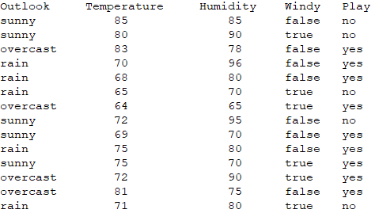
RESULTS
WEATHER PREDICTION USING RNN
n

